Slide 1
Chapter 2
Important Principles of Measurement
Data: Classroom mathematics test generated by a group of primary school teachers. The test measured area-based concepts.
Items ranged from simple questions such as coloring the surface of a square, to computations based on formulas for area, to advanced skills of calculations based on several formulas.
Table 2.1 – 14 persons and 12 items
The only useful information in this table is that proportion correct ranges between 0/12 to 11/12.
Table 2.2 -- Items are ordered from least difficult to most difficult; persons ordered from least able to most able.
Such a table is called a Scalogram (Guttman, 1944).

Slide 2
Zero and Perfect scores
Omit persons with perfect scores and zero scores.
These individuals (items) are substantially below or above the operating level of the test items.
To estimate a finite measure we will have to find a test more appropriate to their level of ability.
It is tempting to say “complete mastery”. This is only true if test questions contained the most difficult (easiest) item that could ever be written for the variable. It is always possible more difficult items could be written resulting in incorrect answer revealing mastery is not complete.
Similarly delete items which every one answers on no one answers.

Slide 3
Remove person M, then item c.
Table 2.3 – 13 persons and 11 items
Observe the pattern of responses for persons and items:
1’s decrease as you move from Left to Right & Top to Bottom.
Person A displays Guttman pattern; most human behavior not so perfectly predictable.
Person I & F– nearly perfect (unexpected success on difficult item)
Persons E & L – missed very easy items, do not match expected pattern
Persons C & I -- similar
Person K – erratic and unpredictable; Is a score of 5 fair to solve area problems?

Slide 4
Similar pattern for items:
Items I, b, h, & g -- Guttman like pattern; easy to predict student performance on these items.
Item d – difficult; responses erratic; impossible to predict who will succeed; high performance persons C, E, L failed this item.

Slide 5
Inadequacy of raw scores of ability & difficulty as measures of scale
Figure 2.1 page 31
Raw scores or percentages clump students around middle scores.
Ability differences around the mean score does not refer to the same ability difference at the top of the scale or bottom of the scale.
e.g., 46% correct to 50% correct does not refer to the same ability difference at the top of the scale 95% to 99% or bottom of the scale 10% to 14% correct.
All we can infer is the ordering of persons and items.
It will be good to have a scale where we can say, “Betty shows more ability than John by this much”.

Slide 6
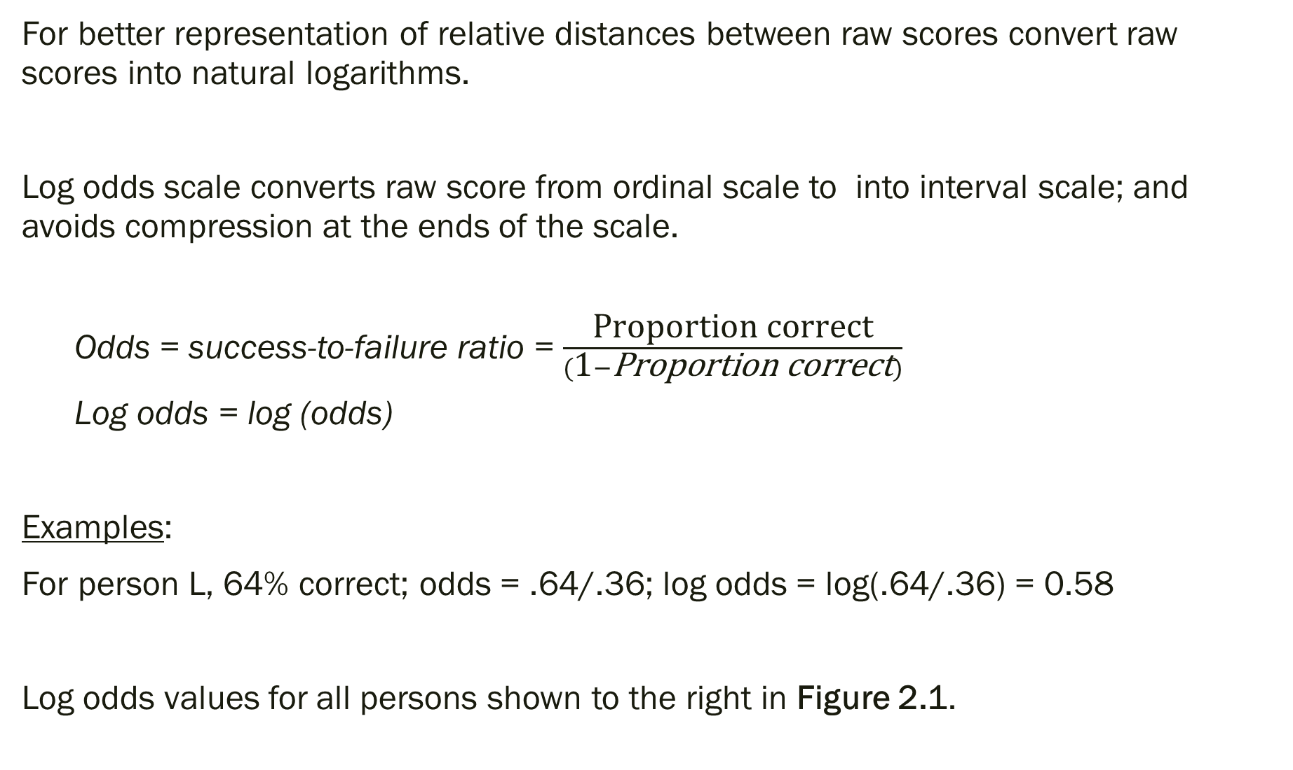
For better representation of relative distances between raw scores convert raw scores into natural logarithms.
Log odds scale converts raw score from ordinal scale to into interval scale; and avoids compression at the ends of the scale.
Odds = success-to-failure ratio = $\frac{\text{Proportion} \text{correct}}{(\text{1}−\text{Proportion} \text{correct})}$
Log odds = log (odds)
Examples:
For person L, 64% correct; odds = .64/.36; log odds = log(.64/.36) = 0.58
Log odds values for all persons shown to the right in Figure 2.1.

Slide 7
Log odds values for persons shown to the right in Figure 2.1.
Extreme scores X, Y, Z are added for illustration purposes.
Distance between persons with extreme scores is now stretched out:
Between X&Y and Z&N.
Distance between persons B & H each with one score point difference at the lower end of the scale or between J&N at the upper end of the scale is larger than the difference in the middle between A & I.
Increase in ability required to move between 90% to 95% is considerable larger than between 50% to 55%.

